Slide 1
Data Envelopment Analysis
Chapter 17

Slide 2
Multi-Site Services
Midas (brake/muffler repair) >2,700
Budget Rent-A-Car >3,200
McDonald’s >30,000
Bank of America >4,400

Slide 3
Multi-Site Services
Novus windshield repair >2,200
Subway (sandwiches) 17,500
Heel Quick (shoe repair) 732
Radio Shack 7,113
Snap-On (tools) 4,680
Citibank case
Notes:
The Harvard B.School case on Citibank: performance evaluation is recommended to inspire the topic. I use the case for 10-15 minutes of actual discussion, but the real use is framing the issue of what is a fair system for performance evaluation.

Slide 4
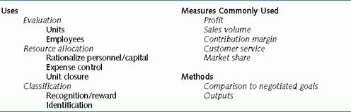
Characteristics of Performance Evaluation Systems

Slide 5
Data Envelopment Analysis (DEA)
Use – efficiency evaluation for multi-site service firms
DEA Output – Single number
  Most favorable linear combination of outputs/inputs to unit compared to the outputs/inputs of all other units
Conditions for use:
  Results ambiguity
  Results measurement incompatibility
  Service unit similarity

Slide 6
Advantages of DEA
Data reduction
Objectivity
Environmental change response
Doesn’t reward sand-bagging
Doesn’t punish superior performers

Slide 7
Applications of DEA
Over 1,800 academic articles (through summer 2001)
Non-profit
  Education, health care, armed forces, public housing, transportation, facility location (superconducting supercollider)
For-profit
  Banking, retail, mining, agriculture

Slide 8
Commercial Software
“Frontier Analyst” by Banxia
“Ideas 6” by 1 Consulting

Slide 9
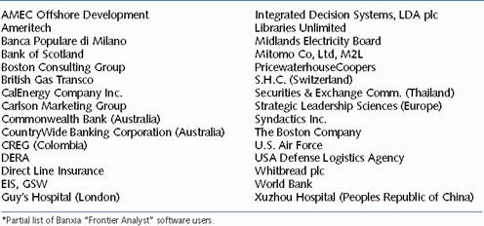
A Sample List of Corporate
Users of DEA*

Slide 10
DEA in Retail Banking
Al‑Faraj, T., A. Alidi and K. Bu‑Bshait (1993), “Evaluation of Bank Branches by Means of Data Envelopment Analysis,” International Journal of Operations & Production Management, 13, 9, 45‑52.
Athanassopoulos, A. (1997), “Service Quality and Operating Efficiency Synergies for Management Control in the Provision of Financial Services: Evidence from Greek Bank Branches,” European Journal of Operational Research, 98, 300-313.
Chase, R., G. Northcraft and G. Wolf (1984), “Designing High-Contact Service Systems: Application to Branches of a Savings and Loan,” Decision Sciences, 15, 542-555.
Drake, L . and B. Howcroft (1994), “Relative efficiency in the Branch Network of a UK Bank: An Empirical Study,” Omega, 22, 1, 83‑90.
Giokas, D. (1991), “Bank Branch Operating Efficiency: A Comparative Application of DEA and the Loglinear Model,” OMEGA, 19, 6, 549-557.
Haag, S. and P. Jaska (1995), “Interpreting Inefficiency Ratings: an Application of Bank Branch Operating Efficiencies,” Managerial and Decision Economics, 16, 7‑14.
Parkan, C. (1994), “Operational Competitiveness Ratings of Production Units,” Managerial and Decision Economics, 15, 201‑221.

Slide 11
DEA in Retail Banking
Pastor, J. (1994), “How to Discount Environmental Effects in DEA: An Application to Bank Branches,” Working Paper, Universidad de Alicante, Alicante, Spain.
Roll, Y. and B. Golany (1993), “Alternative Methods of Treating Factor Weights in DEA,” Omega, 21, 1, 99‑109.
Schaffnit, C., D. Rosen and J. Paradi (1997), “Best Practice Analysis of Bank Branches: An Application of DEA in a Large Canadian Bank,” European Journal of Operational Research, 98, 269-289.
Sherman, H. (1984), “Improving the Productivity of Service Businesses,” Sloan Management Review, 11‑22.
Sherman, H. and F. Gold (1985), “Bank Branch Operating Efficiency,” Journal of Banking and Finance, 9, 297‑315.
Sherman, H. and G. Ladino (1995), “Managing Bank Productivity Using Data Envelopment Analysis (DEA)”, Interfaces, 25, 2, 60‑73.

Slide 12
Structure of DEA Models
Efficiency = Outputs/Inputs
Efficiency rating from 0 (worst) to 1 (best)
Maximize Outputs/Inputs of a specific service unit
Subject to: Outputs/Inputs ≤ 1 for every service unit
No a priori weighting of outputs or inputs assumed

Slide 13
Structure of DEA Model
Linear model
  constants: outputs, inputs
  variables: output weights, input weights
Analyze units one at a time
Maximize Outputs_{i} x Output weight (specific unit j)
subject to:
  [(outputs_{i} x output weight)/(inputs_{i} x input weight) ≤ 1] or
  (outputs_{i} x output weight) – (inputs_{i} x input weight) ≤ 0
  For all other units:
  Inputs_{j} x input weight = 1 for specific unit j

Slide 14
DEA Example Problem Data
Branch | Inputs | Loans | Deposits
A | 100 | $10 | $31
B | 100 | 15 | 25
C | 100 | 20 | 30
D | 100 | 23 | 23
E | 100 | 30 | 20

Slide 15
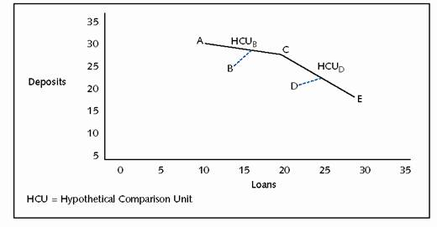
DEA Example Problem Graph

Slide 16
DEA Example Problem Data
Branch | Loans | Deposits | Efficiency
A | $10 | $31 | 1
B | 15 | 25 | 0.83
C | 20 | 30 | 1
D | 23 | 23 | 0.92
E | 30 | 20 | 1

Slide 17
Graphical DEA
Standardize the data if necessary
Plot data (using Excel) and draw efficient frontier (using Excel or by hand)
Calculate inefficiencies by calculating distance
Determine what can be improved and by how much in the inefficient branches

Slide 18
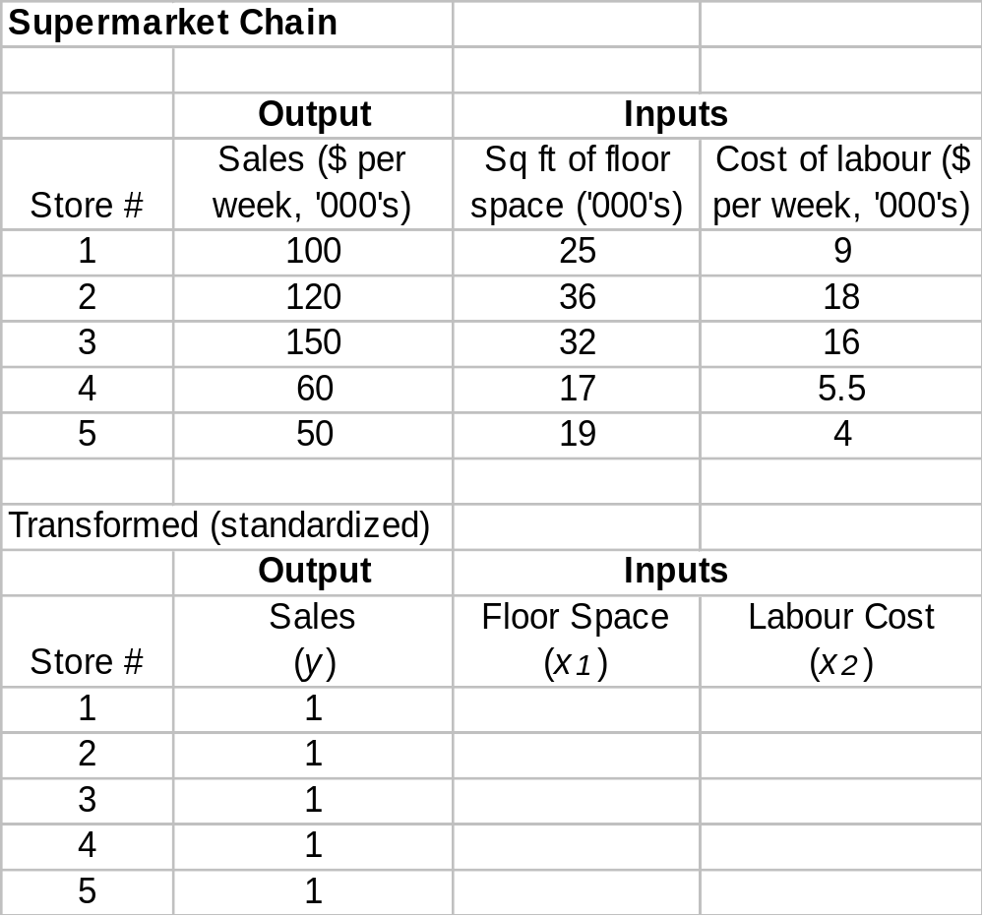
DEA Example
0.25
0.09
0.30
0.15
0.213
0.107
0.283
0.092
0.38
0.08

Slide 19
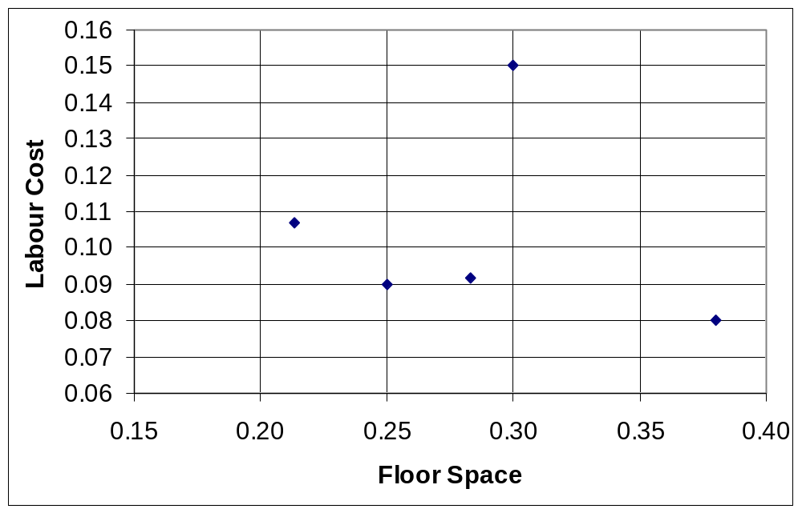
Efficient Frontier
2
2’
3
1
4
4’
5
0
0

Slide 20
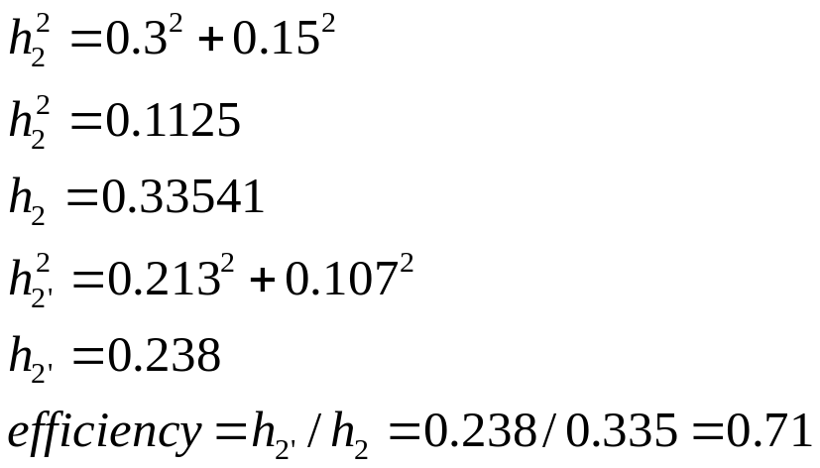
Calculate Efficiencies
h
a
In a right-angled triangle, h² = a² + b²
Calculate the hypotenuse of each triangle and then calculate by what percentage the shorter one is shorter than the longer one
  E.g. for Branch 2:
b

Slide 21
Chapter Summary
DEA can be a useful tool, but under the proper circumstances
  Depends on numerous facilities that
    Attempt roughly the same task
    Where the firm has true goal ambivalence
    When multiple measures of performance are appropriate
  DEA is a superior technique to the standard business practice of analyzing ratios at the unit level
  DEA evaluates the entire package of inputs and outputs to assess performance

